Slide 1
AWS DATABASES
PHANI KISHORE LANKA

Slide 2
DATABASES
RDS (Relation DB) - OLTP
Servered – MYSQL, SQL Server, Oracle, PostGres , Maria DB
Serverless – Aurora (High Performance MySQL)
DynamoDB – AMAZON No SQL DB
ElastiCache – Cached DB on Cloud (Memcached/Redis Flavours)
Neptune – Graph Based Database Engine
Amazon Redshift – BI on AWS (OLAP)
Amazon DocumentDB – Operate Mongo DB Compatible Databases

Slide 3
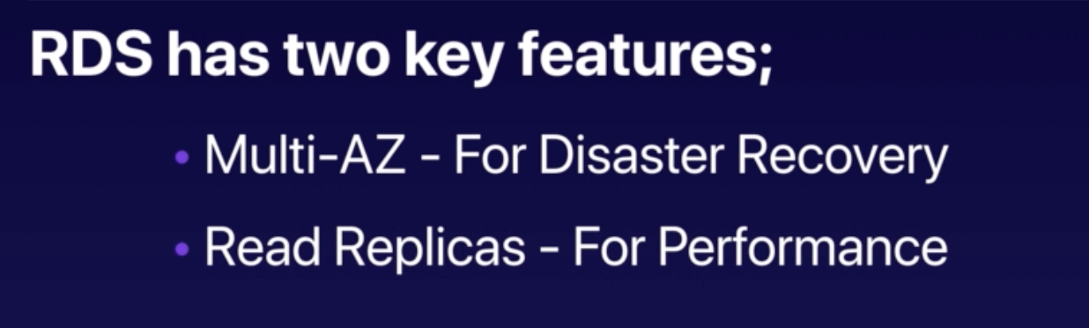
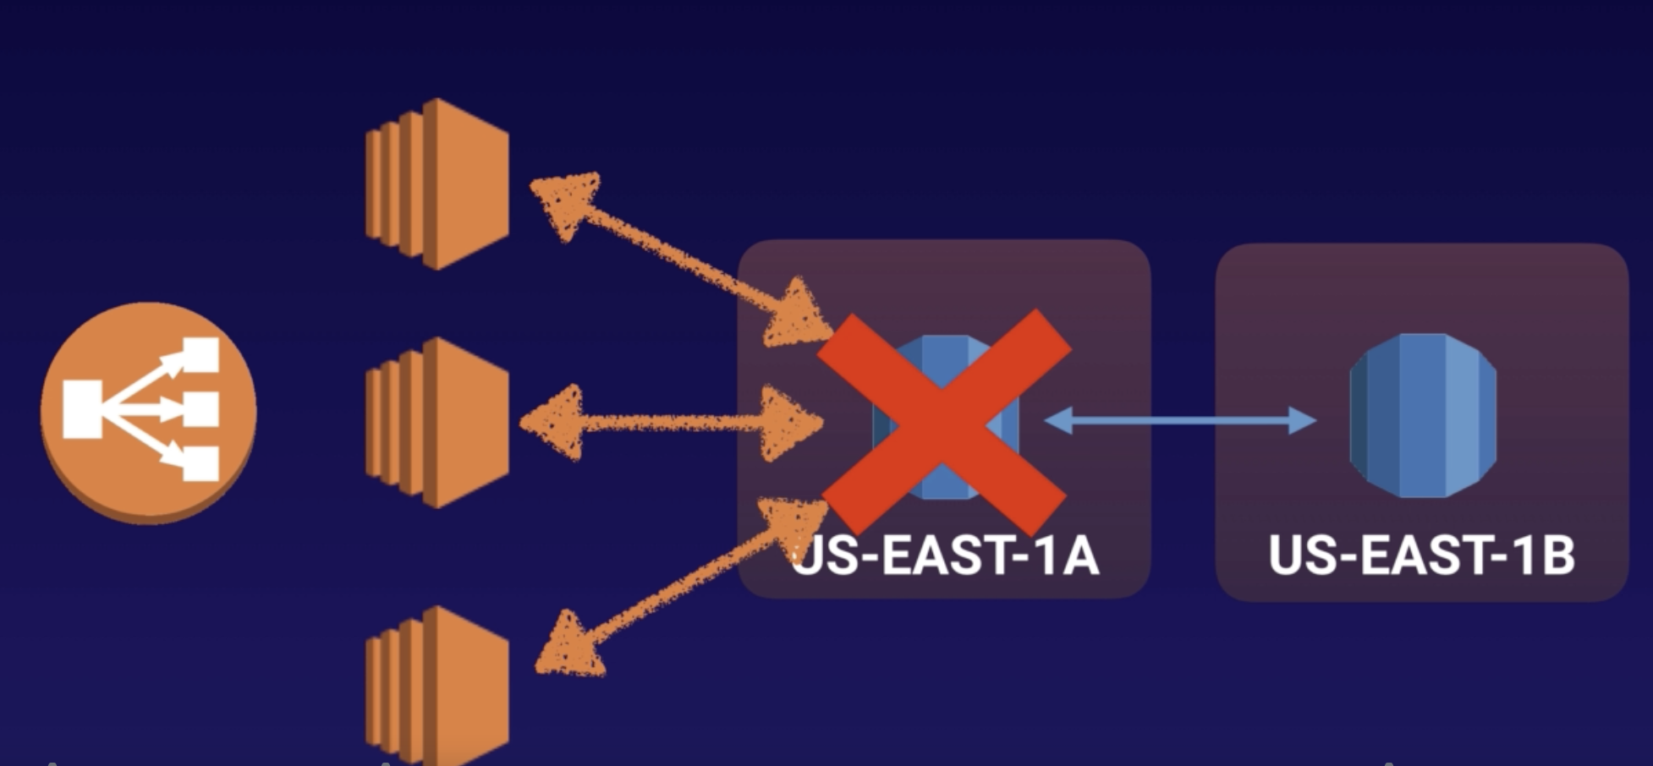
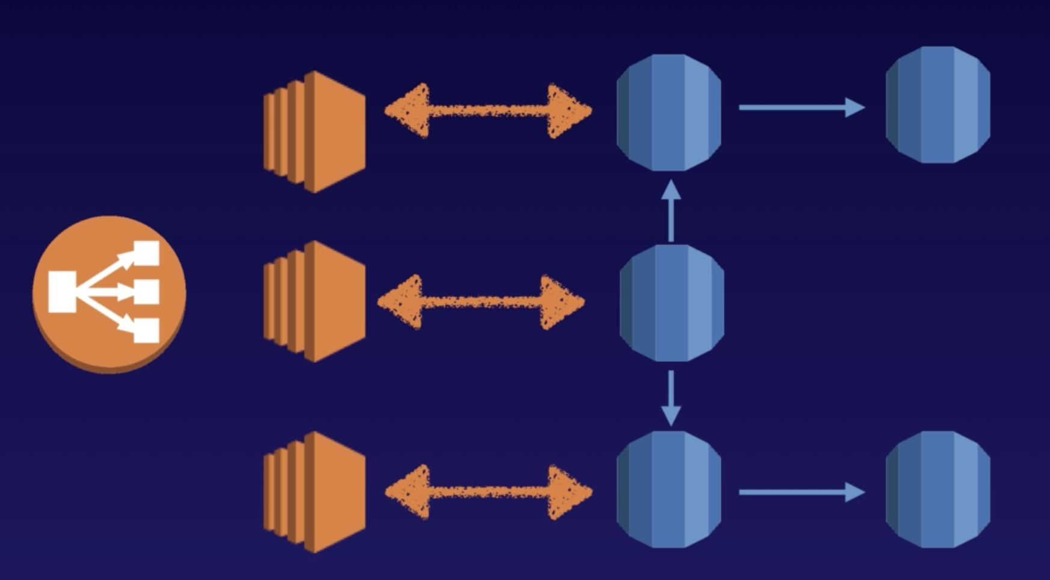
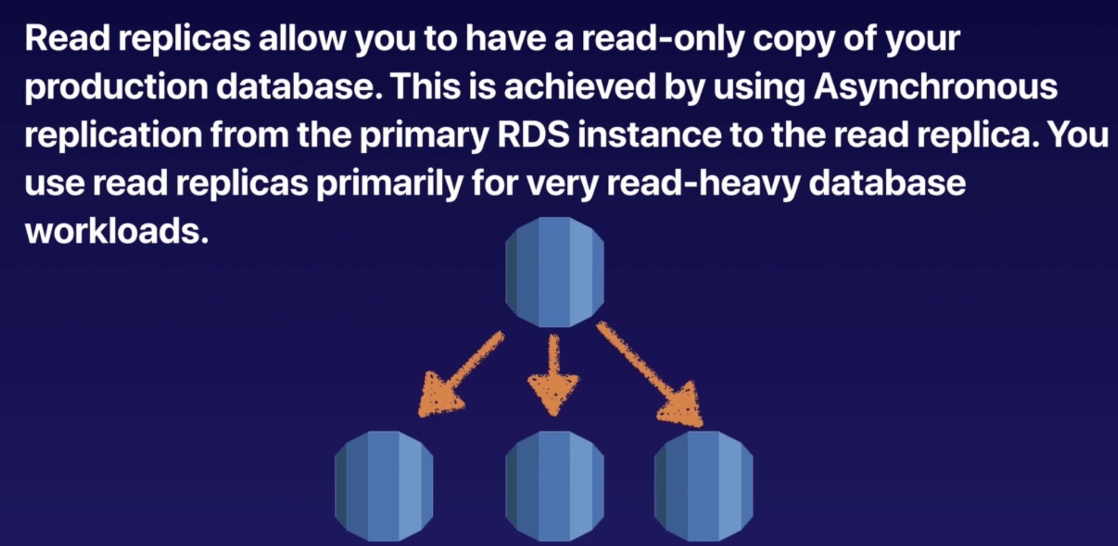
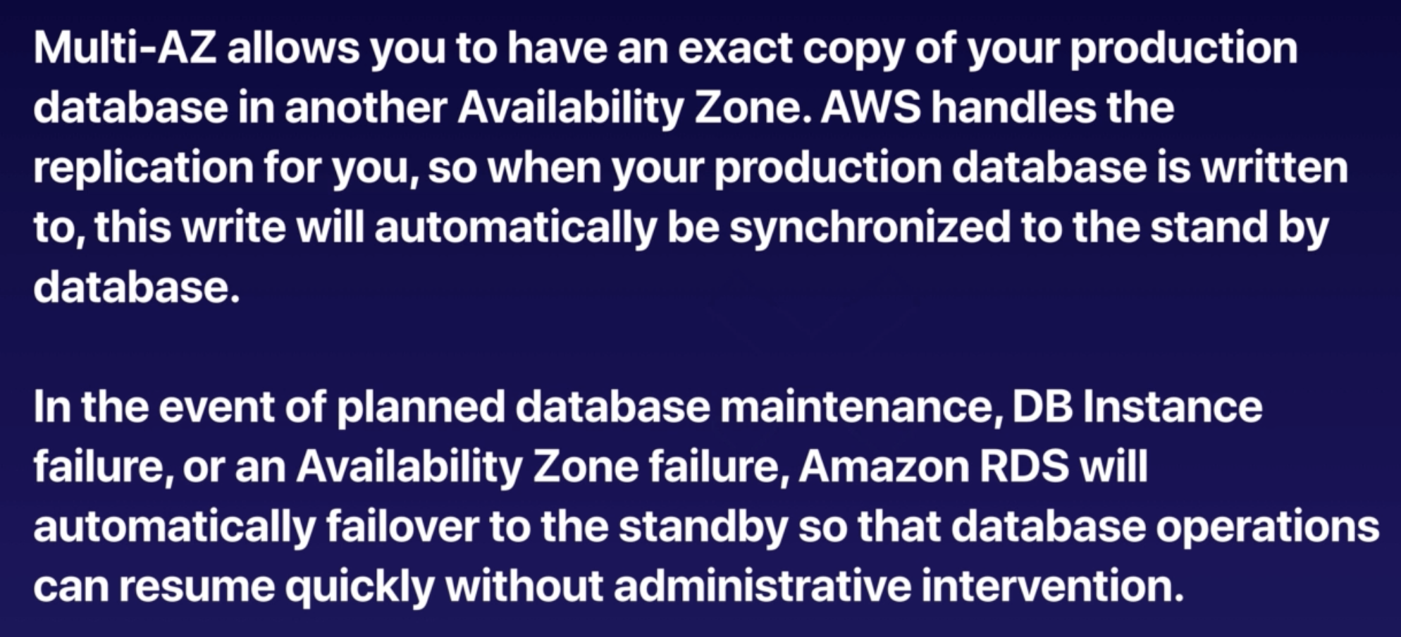
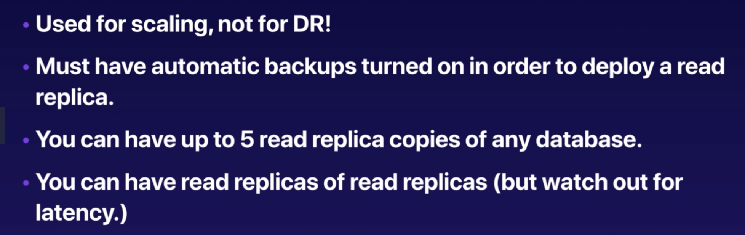
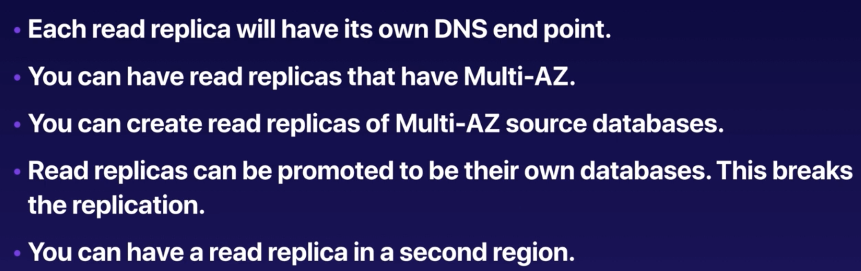
RDS Key Features
MULTI-AZ
Read Replicas

Slide 4
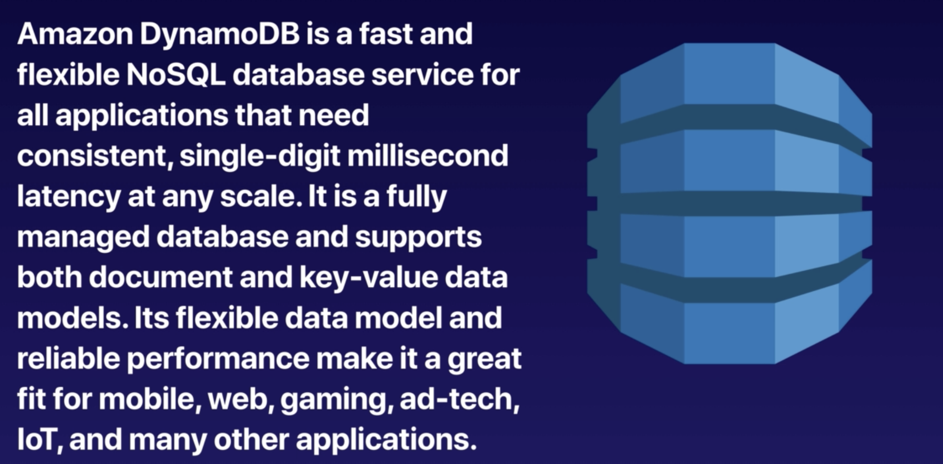
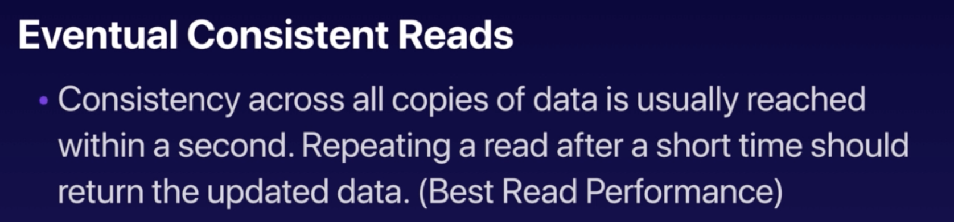
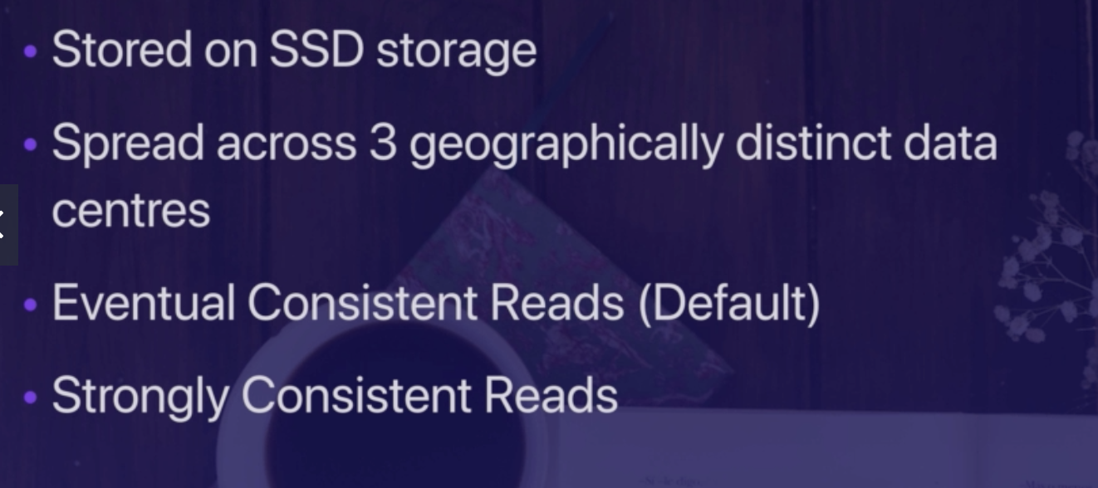

Dynamo DB

Slide 5
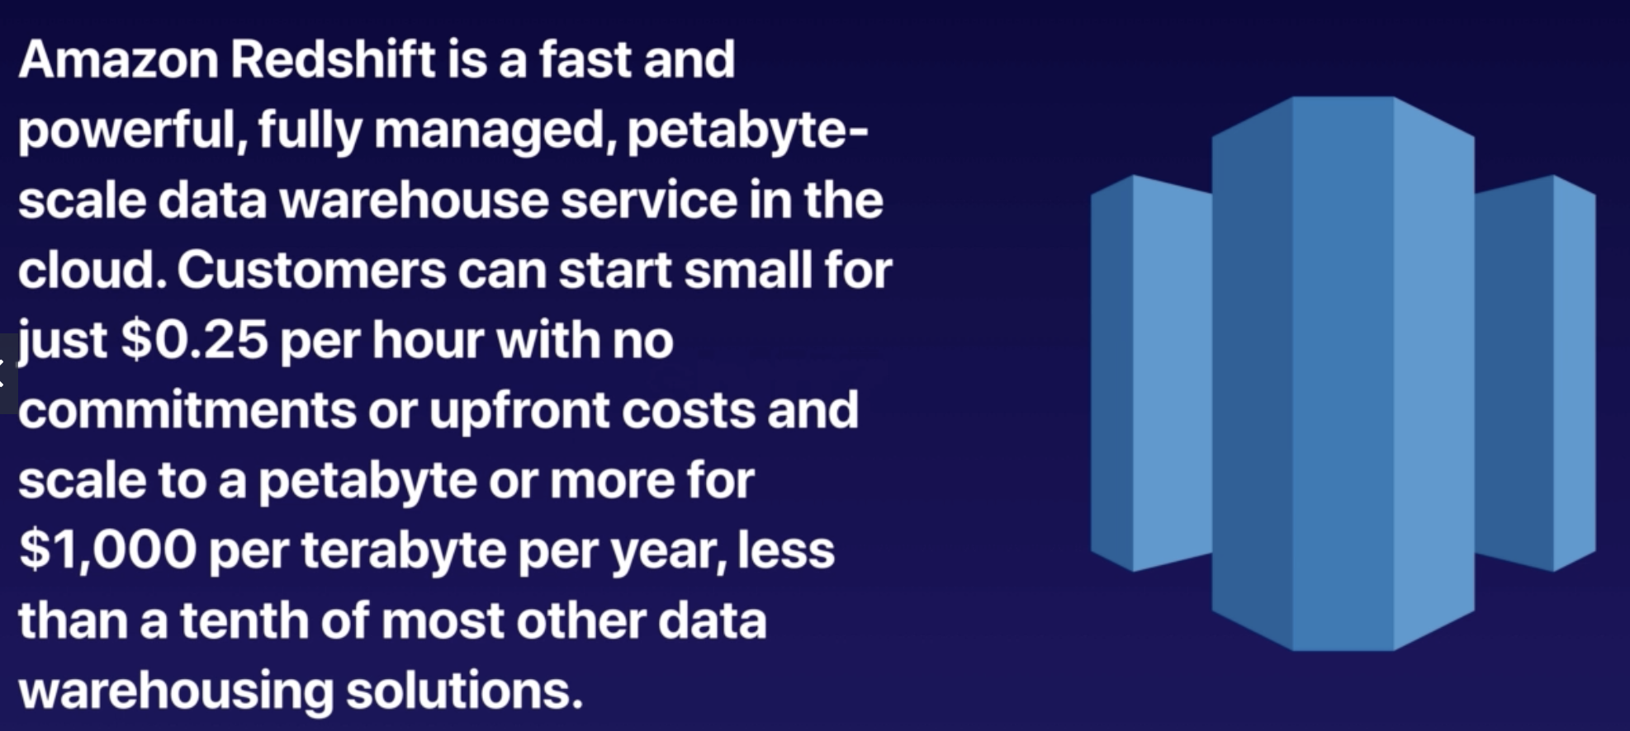
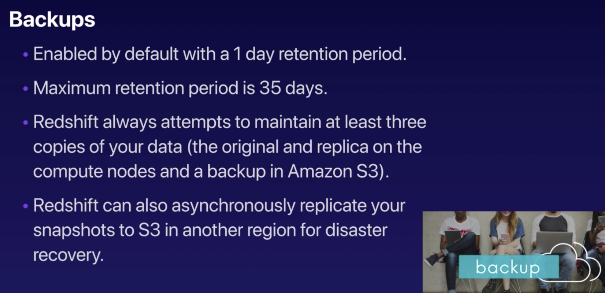
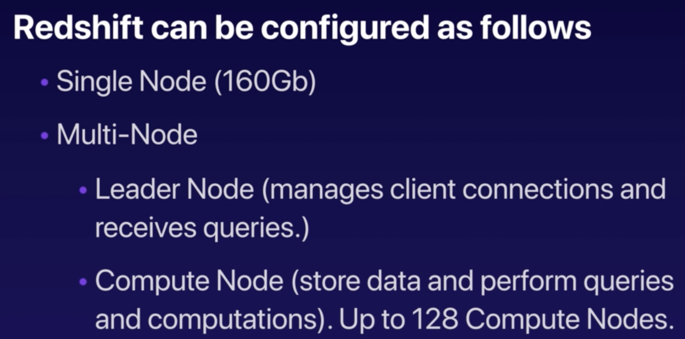
RedShift – BI Solution

Slide 6
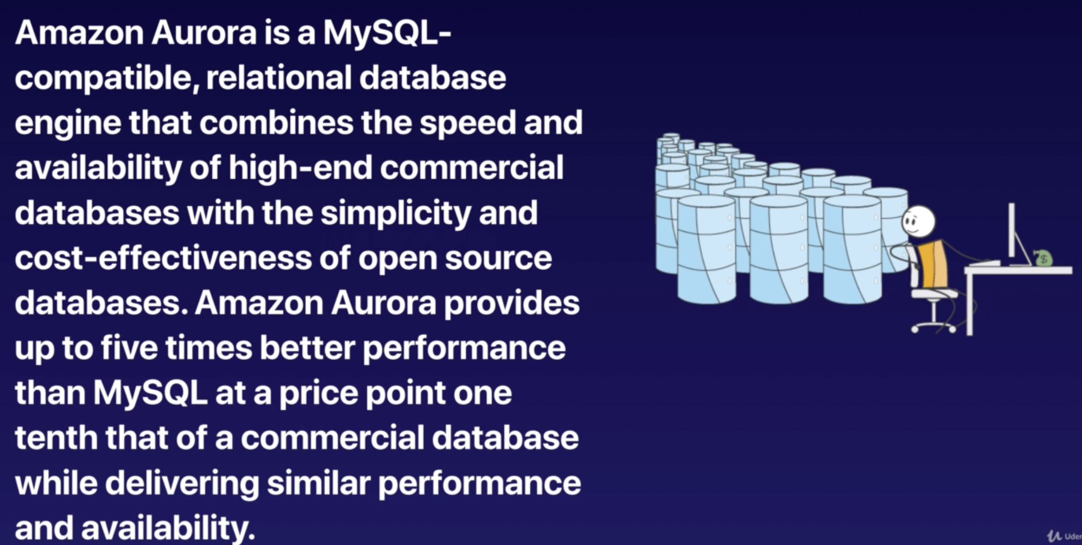
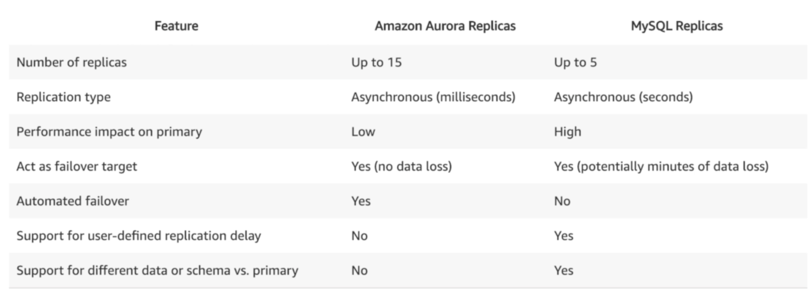
AMAZON Aurora
AMAZON Built from Scratch
It supports PostGres SQL , My SQL
It can be serverless
High Performance Maintained by Amazon

Slide 7
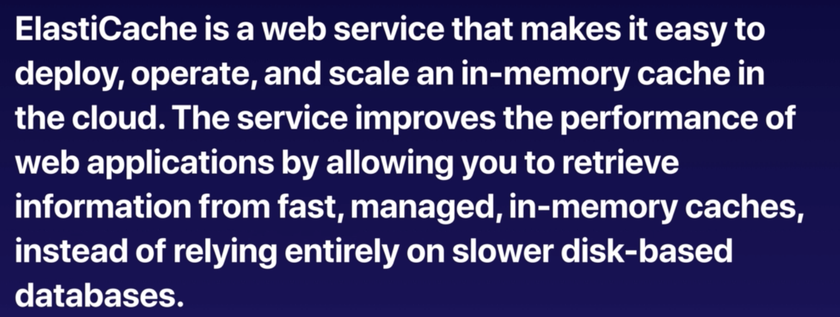
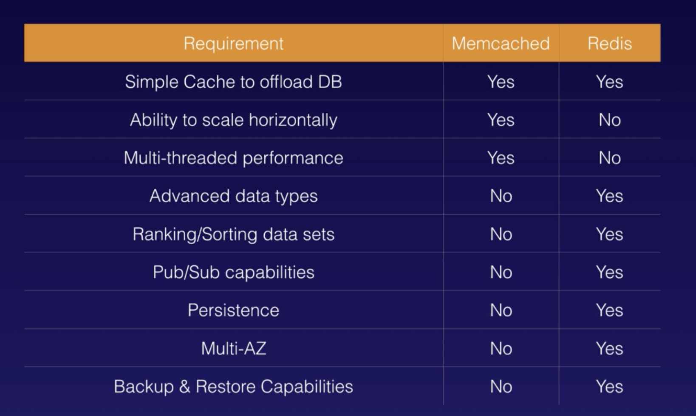

Elastic Cache

